Slide 1
An Investigation of Homoclinic Orbits in the Circular Restricted Three-Body Problem
Luke Bury & Don Kuettel
05/02/18

Slide 2
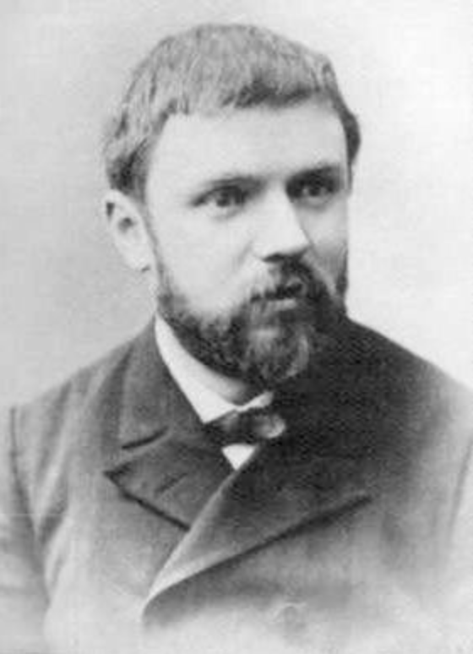
Poincaré
1854-1912
French mathematician/ polymath
Contributions to:
Celestial mechanics
Fluid mechanics
Optics
Electricity
Telegraphy
Elasticity
Thermodynamics
Quantum Theory
Theory of Relativity
More…^{[*1]}
[*1] - https://en.wikipedia.org/wiki/Henri_Poincare

Slide 3
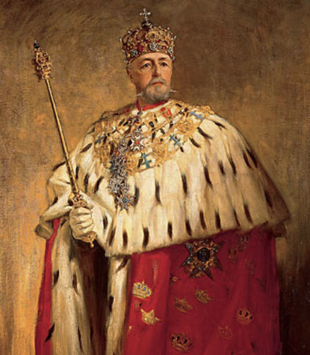
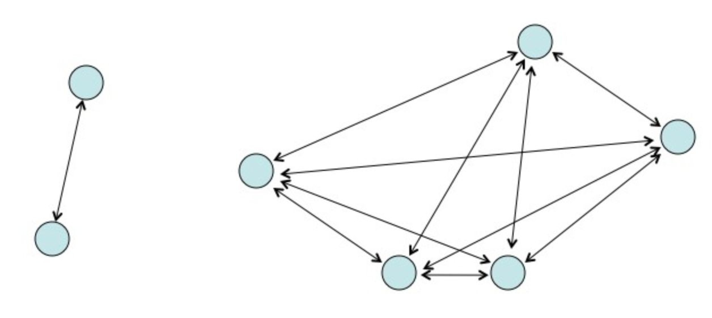
The Competition
Acta Mathematica, 1885
King Oscar II of Sweden
4 unanswered problems
Solve the N-Body Problem
Poincaré went for the Circular Restricted Three Body Problem (CR3BP)
Submitted and won
Critical error discovered around the time of the earliest printings
Led to discovery of Homoclinic Orbits
[*2]https://commons.wikimedia.org/wiki/File:Oscar_II_of_Sweden_painted_by_Oscar_Bj%C3%B6rck_(original).jpg
[*3] - http://www.askamathematician.com/2011/10/q-what-is-the-three-body-problem/
Notes:
-Sponsored by the King
-[*2] - https://commons.wikimedia.org/wiki/File:Oscar_II_of_Sweden_painted_by_Oscar_Bj%C3%B6rck_(original).jpg
-[*3] - http://www.askamathematician.com/2011/10/q-what-is-the-three-body-problem/

Slide 4
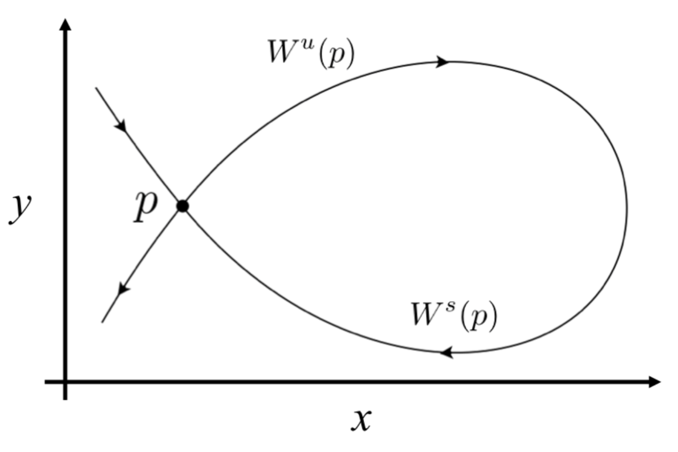
Homoclinic Orbits
A trajectory which joins a saddle equilibrium point to itself
A union between a stable and unstable manifold
Orbit approaches P at both (+)∞ and (–)∞

Slide 5
Locating Homoclinic Orbits
Periodic orbit (PO)
Stable and unstable manifolds
Manifold intersections via Poincaré sections
Homoclinic points are identified

Slide 6
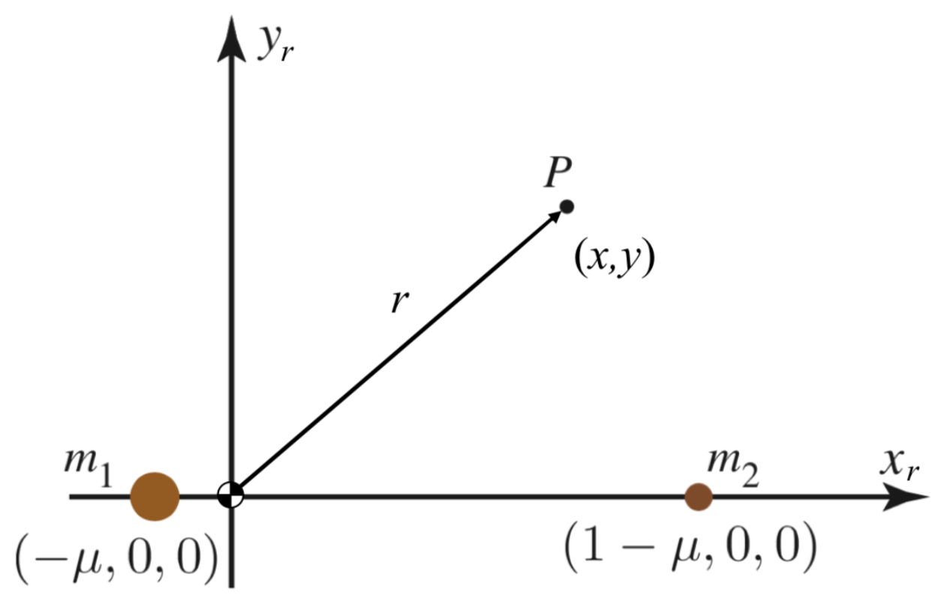
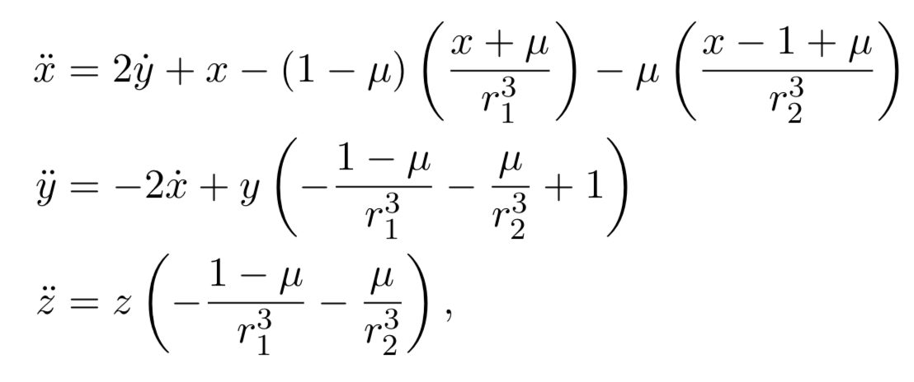
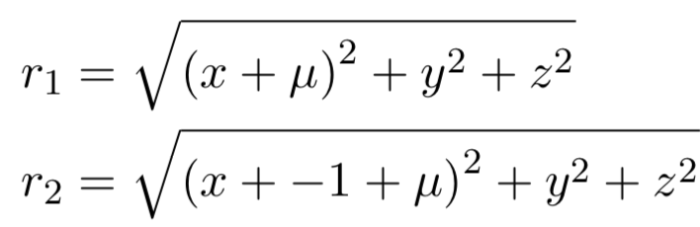
Circular Restricted Three Body Problem
Discuss setup, normalizations

Slide 7
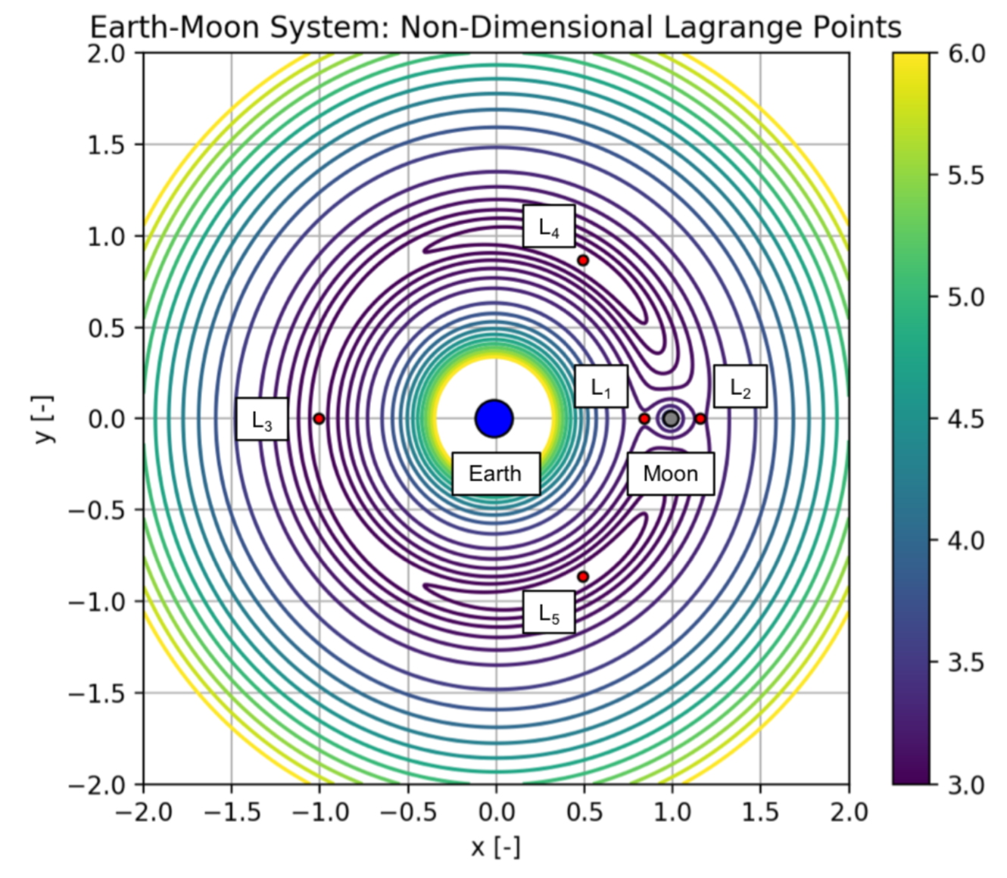
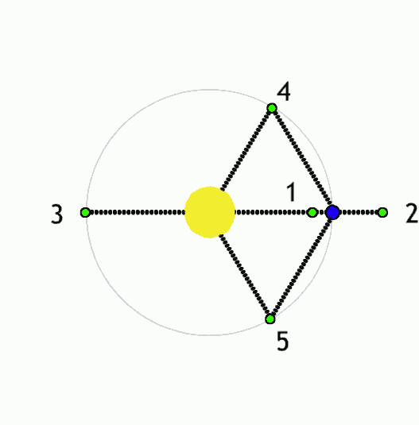
Equilibrium Points & Stability
Discuss saddle & Lyapunov stability
Notes:
Mention Trojan asteroids in Sun-Jupiter L4,5 points
Difficult to solve for. Need to use numerical methods for L1,2,3
L4,5 only stable if M1/M2 > 24.96
ZV curves
Jacobi constant

Slide 8
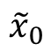
Periodic Orbits & Families
How do we find families of periodic orbits?
The Family Finding Algorithm of course!
y
$${\tilde{x}}_{0}$$
x

Slide 9
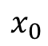
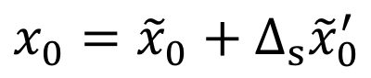
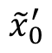
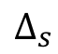
Periodic Orbits & Families
How do we find families of periodic orbits?
The Family Finding Algorithm of course!
y
$${\tilde{x}}_{0}^{′}$$
$$x_{0}={\tilde{x}}_{0}+Δ_{s}{\tilde{x}}_{0}^{′}$$
$$Δ_{s}$$
$$x_{0}$$
$${\tilde{x}}_{0}$$
x

Slide 10
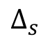
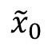
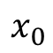
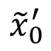
Periodic Orbits & Families
How do we find families of periodic orbits?
The Family Finding Algorithm of course!
y
$${\tilde{x}}_{0}^{′}$$
$$Δ_{s}$$
$$x_{0}={\tilde{x}}_{0}+Δ_{s}{\tilde{x}}_{0}^{′}$$
$$x_{0}$$
$${\tilde{x}}_{0}$$
x

Slide 11
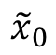
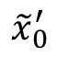
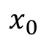
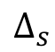
Periodic Orbits & Families
How do we find families of periodic orbits?
The Family Finding Algorithm of course!
y
$$x_{0}$$
$${\tilde{x}}_{0}^{′}$$
$$Δ_{s}$$
$$x_{0}={\tilde{x}}_{0}+Δ_{s}{\tilde{x}}_{0}^{′}$$
$${\tilde{x}}_{0}$$
x

Slide 12
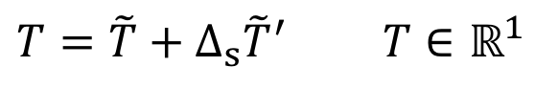
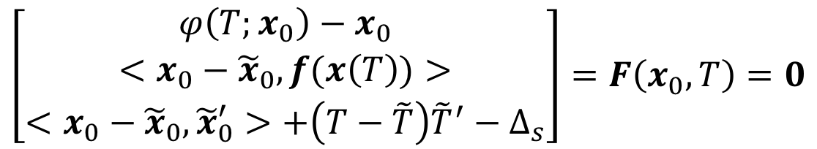
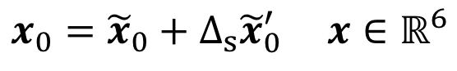
Periodic Orbits & Families
It gets a bit more complicated for periodic orbits.
Correction method uses a single shooter algorithm that solves the follow system of equations.
$$x_{0}={\tilde{x}}_{0}+Δ_{s}{\tilde{x}}_{0}^{′} x∈ℝ^{6}$$
$$T=\tilde{T}+Δ_{s}{\tilde{T}}^{′} T∈ℝ^{1}$$
Definition of periodic orbit
$$\left[\begin{matrix}φ\left(T;x_{0}\right)−x_{0} \\ <x_{0}−{\tilde{x}}_{0}, f(x\left(T\right))> \\ <x_{0}−{\tilde{x}}_{0},{\tilde{x}}_{0}^{′}>+\left(T−\tilde{T}\right){\tilde{T}}^{′}−Δ_{s}\end{matrix}\right]=F\left(x_{0},T\right)=0$$
Poincaré phase constraint
Pseudo-arclength continuation
Notes:
Poincare phase constraint lets us hone in on a single IC point of the infinitely many on the PO
Pseudo-arclength let us hone in on a single periodic orbit from the infinitely many in the family

Slide 13
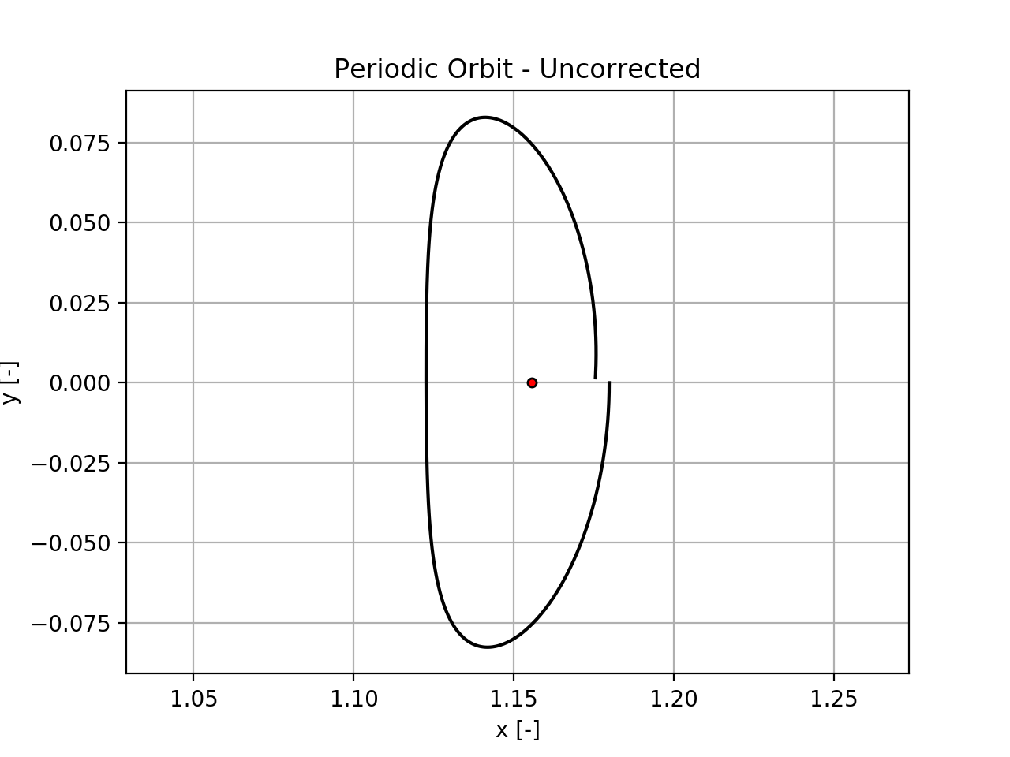
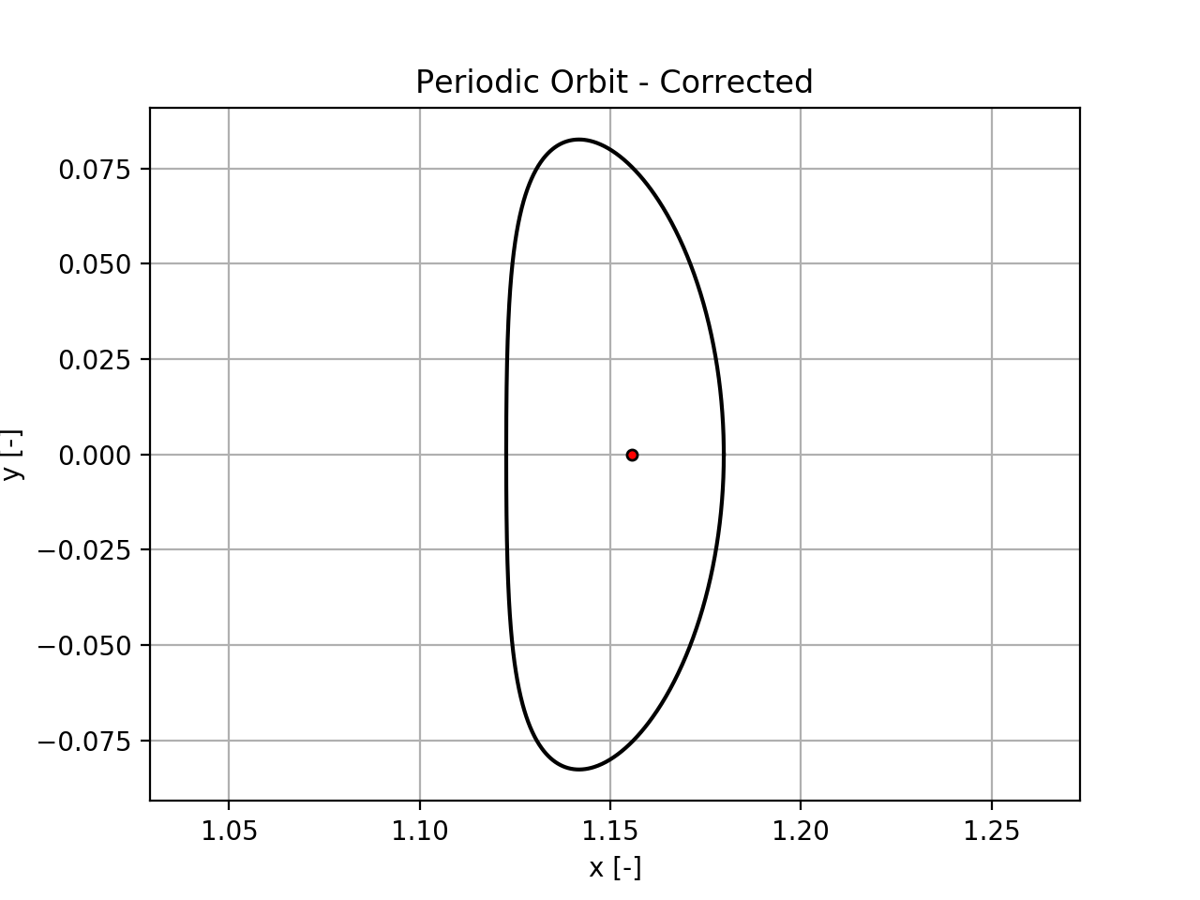
Periodic Orbits & Families

Slide 14
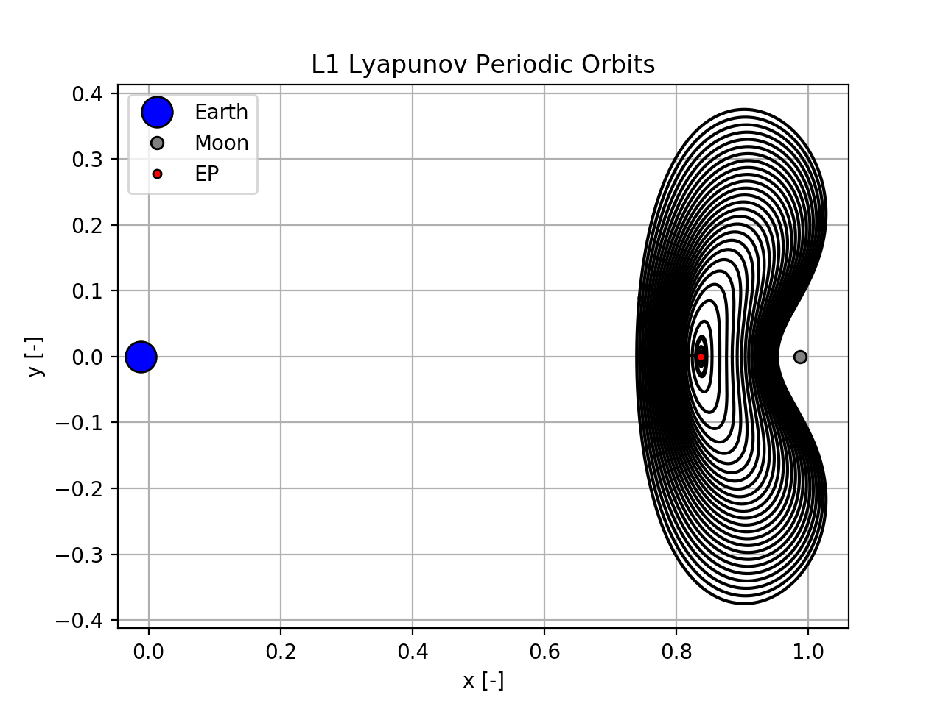
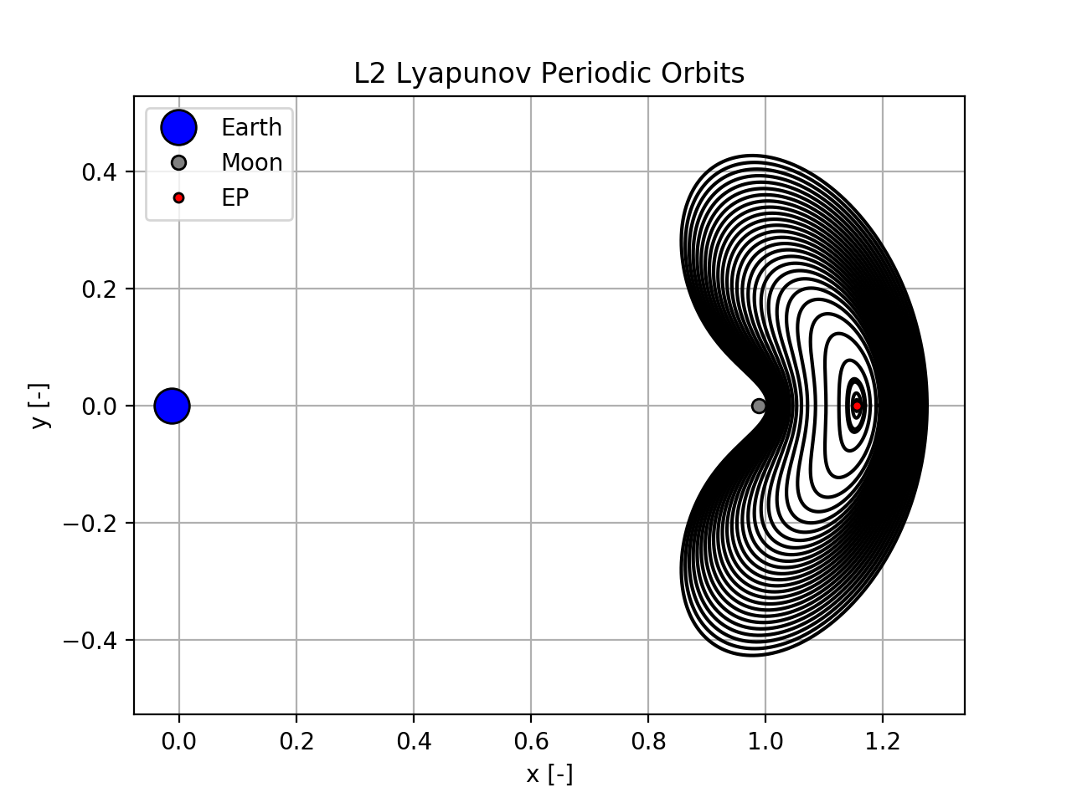
Periodic Orbits & Families

Slide 15
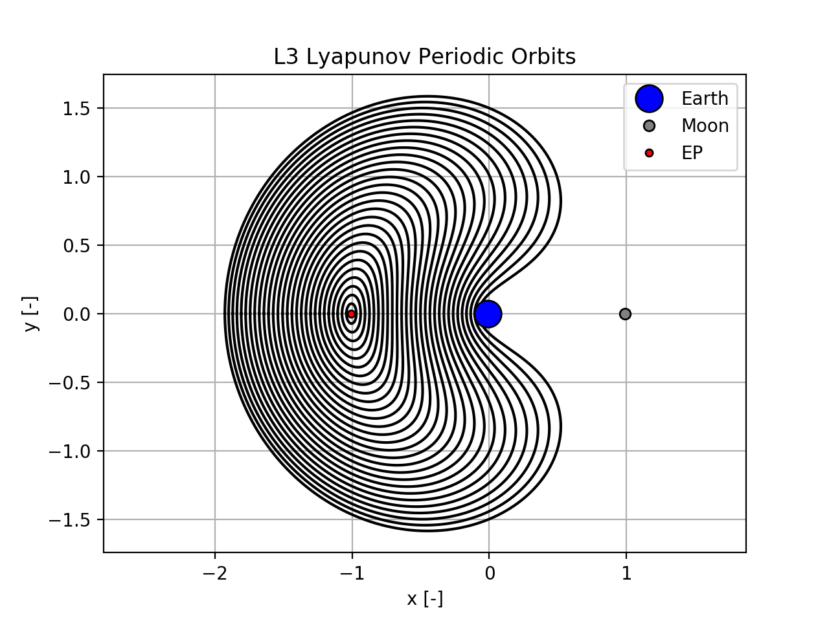
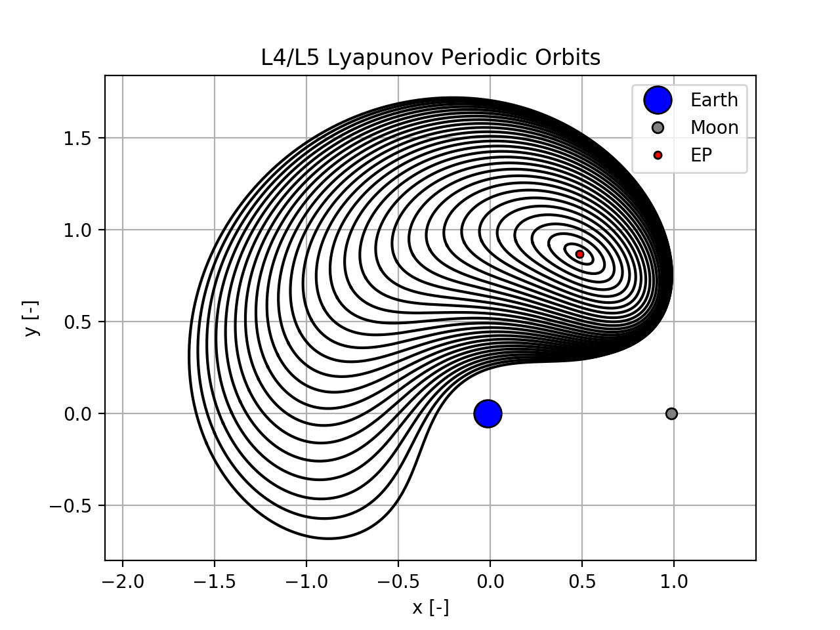
Periodic Orbits & Families

Slide 16
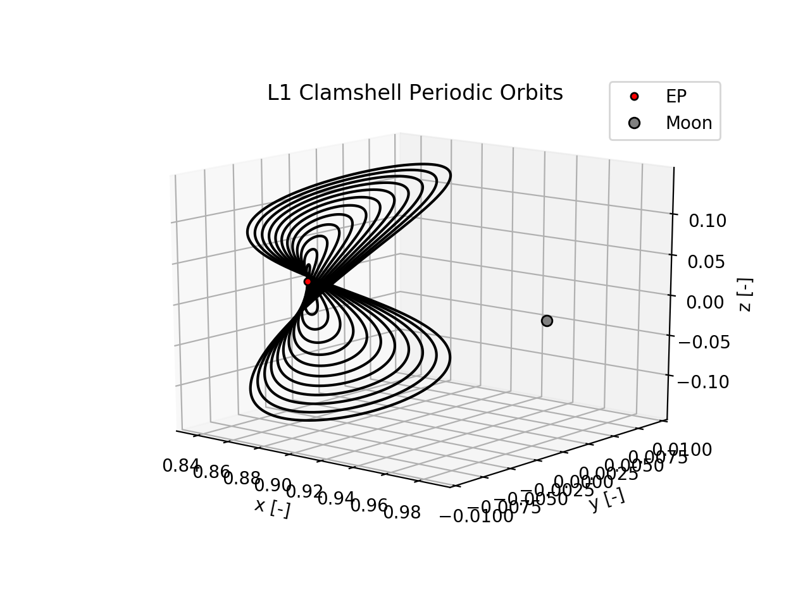
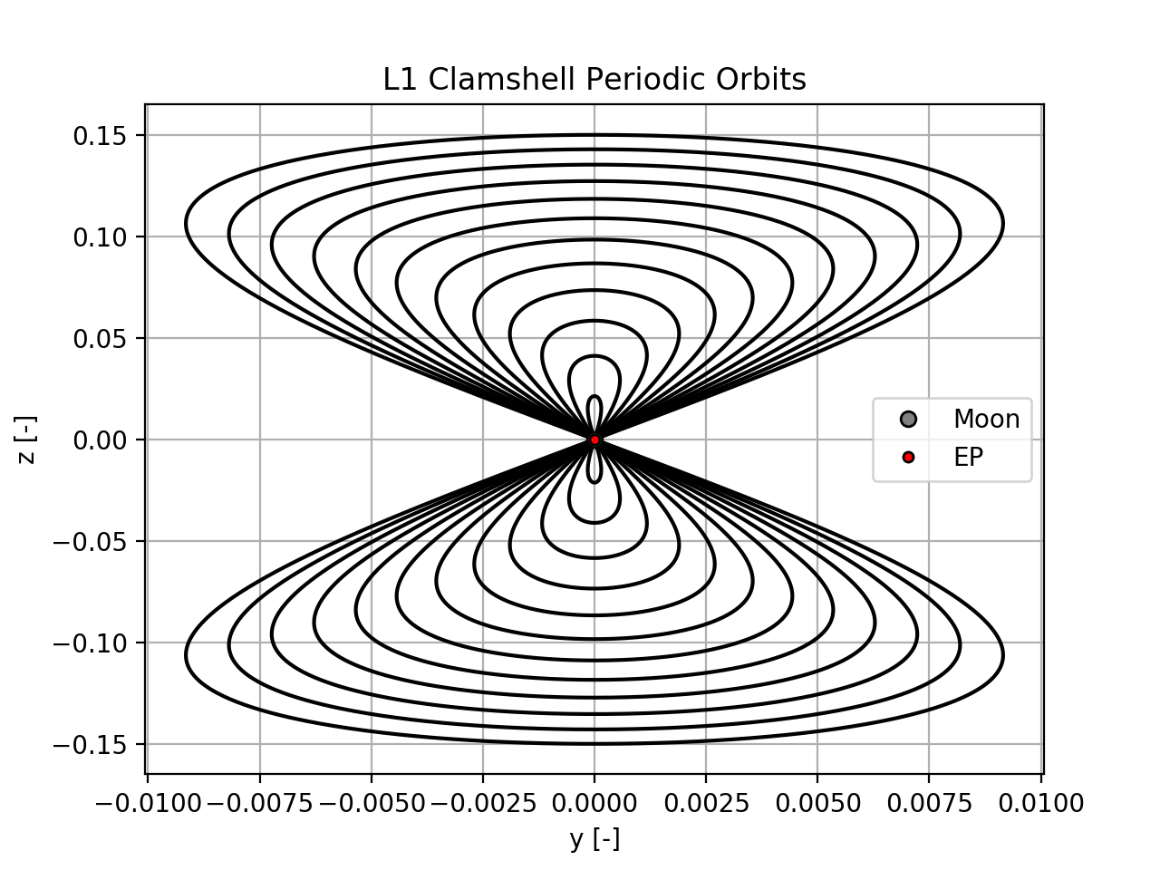
Periodic Orbits & Families

Slide 17
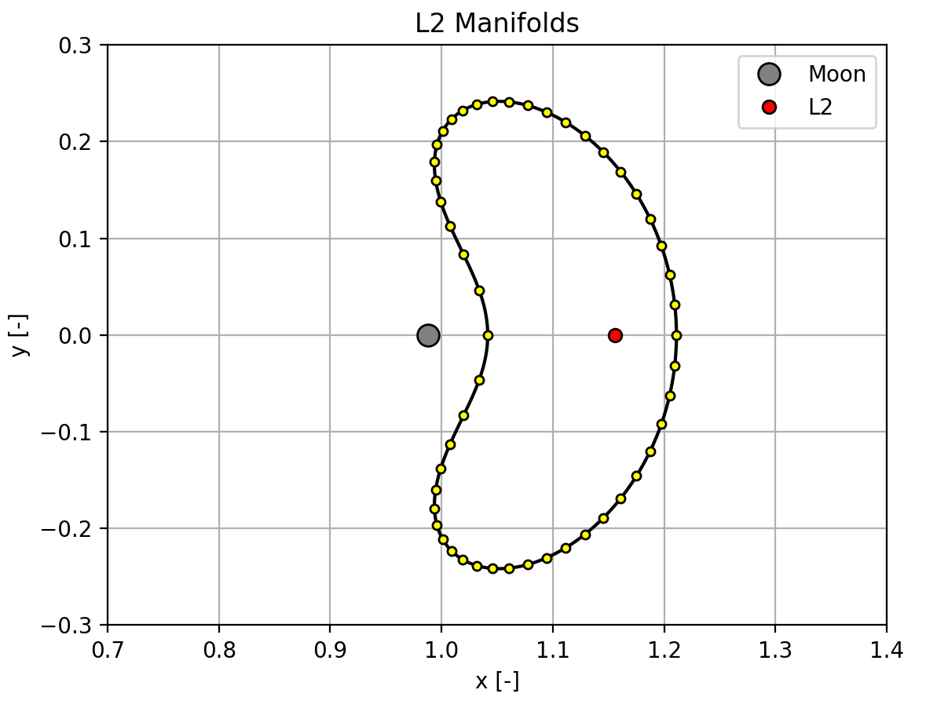
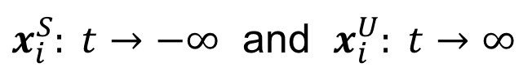
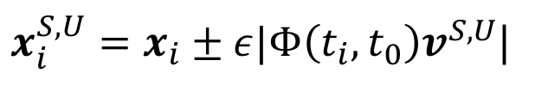
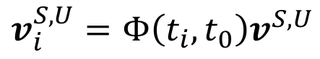
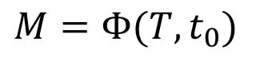
Periodic Orbit Stability & Manifolds
The stability of periodic orbits is determined from the Monodromy matrix.
$$M=Φ(T,t_{0})$$
$$v_{i}^{S,U}=Φ\left(t_{i},t_{0}\right)v^{S,U}$$
$x_{i}^{S,U}=x_{i}±ε|Φ\left(t_{i},t_{0}\right)v^{S,U}$|
$x_{i}^{S}: t→−∞$ and $x_{i}^{U}: t→∞$
Notes:
Discussion of how discretizing and nudging the PO in the stable/unstable direction then propagating backwards/forwards in time reveals manifolds

Slide 18
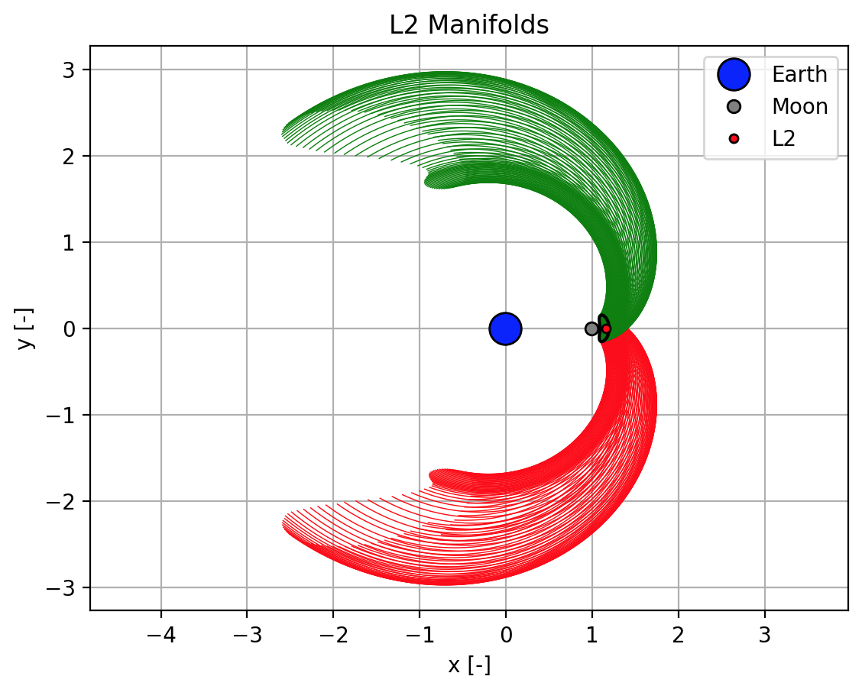
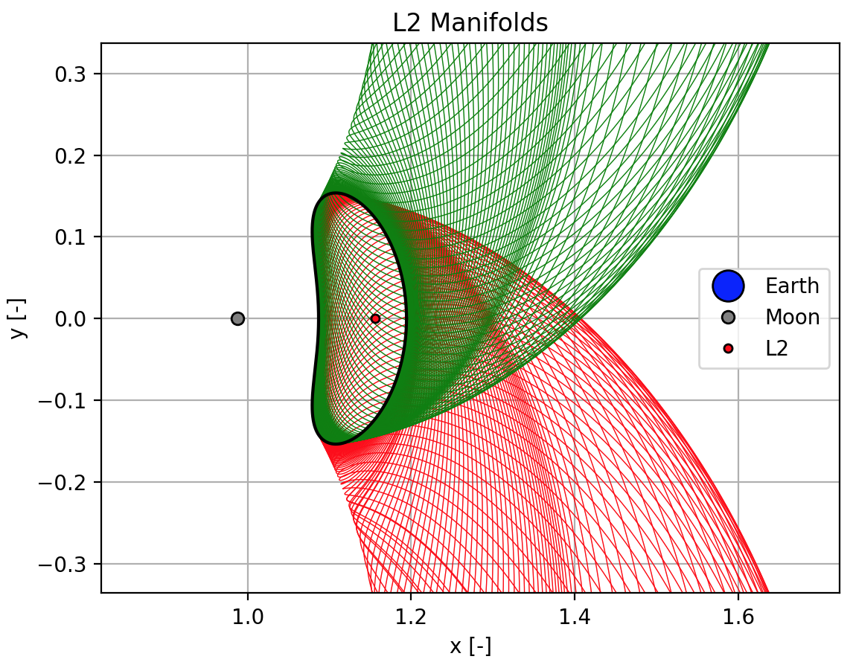
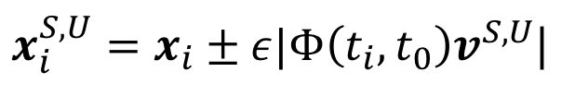
Periodic Orbit Stability & Manifolds
$x_{i}^{S,U}=x_{i}±ε|Φ\left(t_{i},t_{0}\right)v^{S,U}$|
Notes:
Here are the exterior stable and unstable manifolds for a periodic orbit about the L2 Lagrange point.
Each P.O. has interior and exterior stable and unstable manifolds.

Slide 19
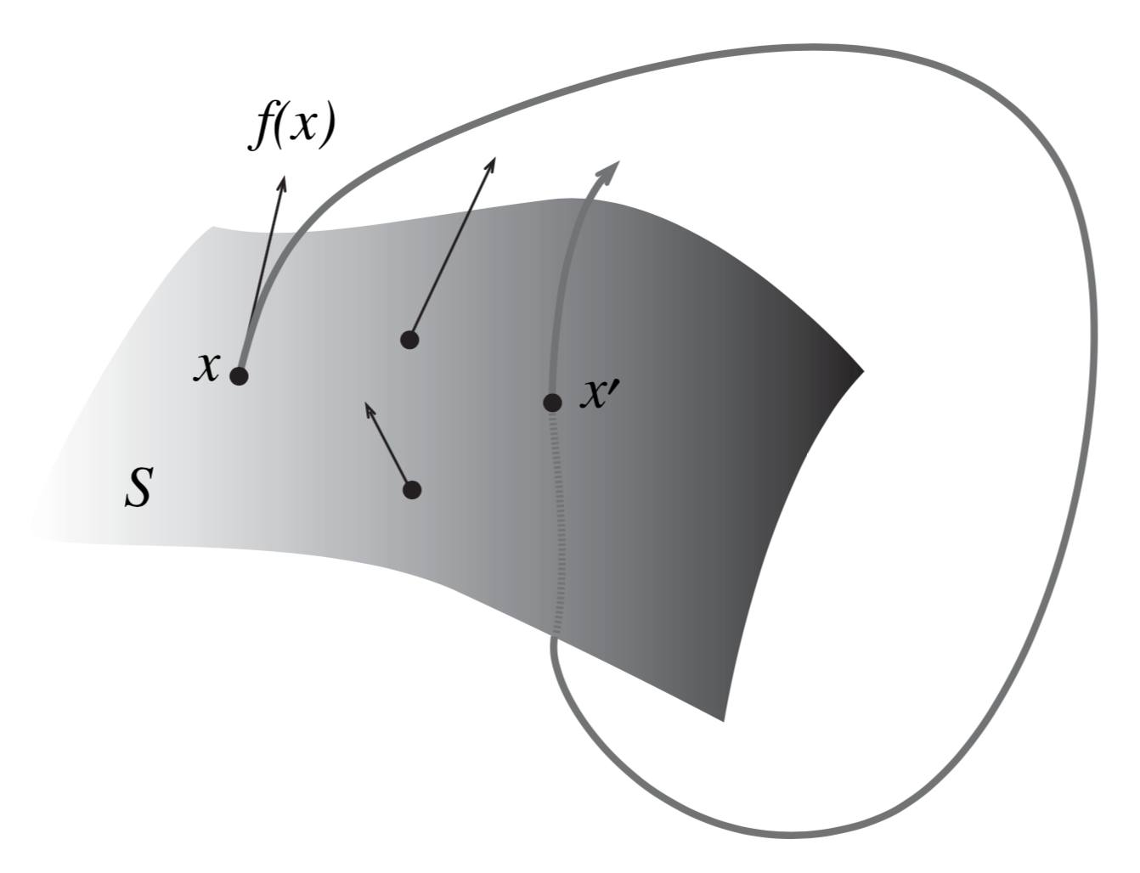
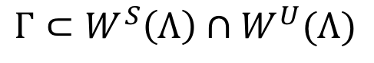
Poincaré Sections & Homoclinic Orbits
Homoclinic orbits occur at the intersection of the stable and unstable manifolds.
In order to find intersections, we use a Poincaré section.
$$Γ⊂W^{S}\left(Λ\right)∩W^{U}(Λ)$$

Slide 20
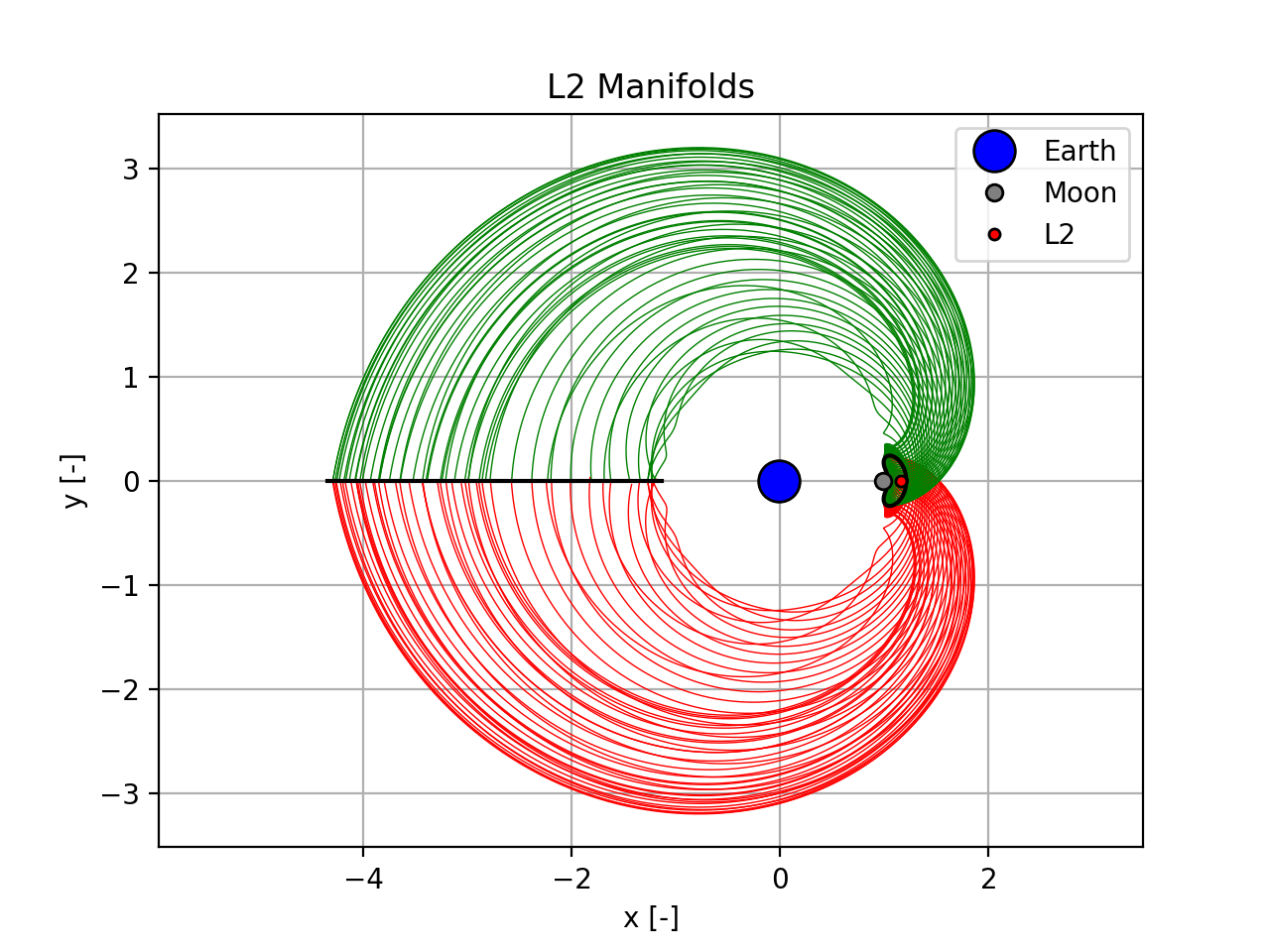
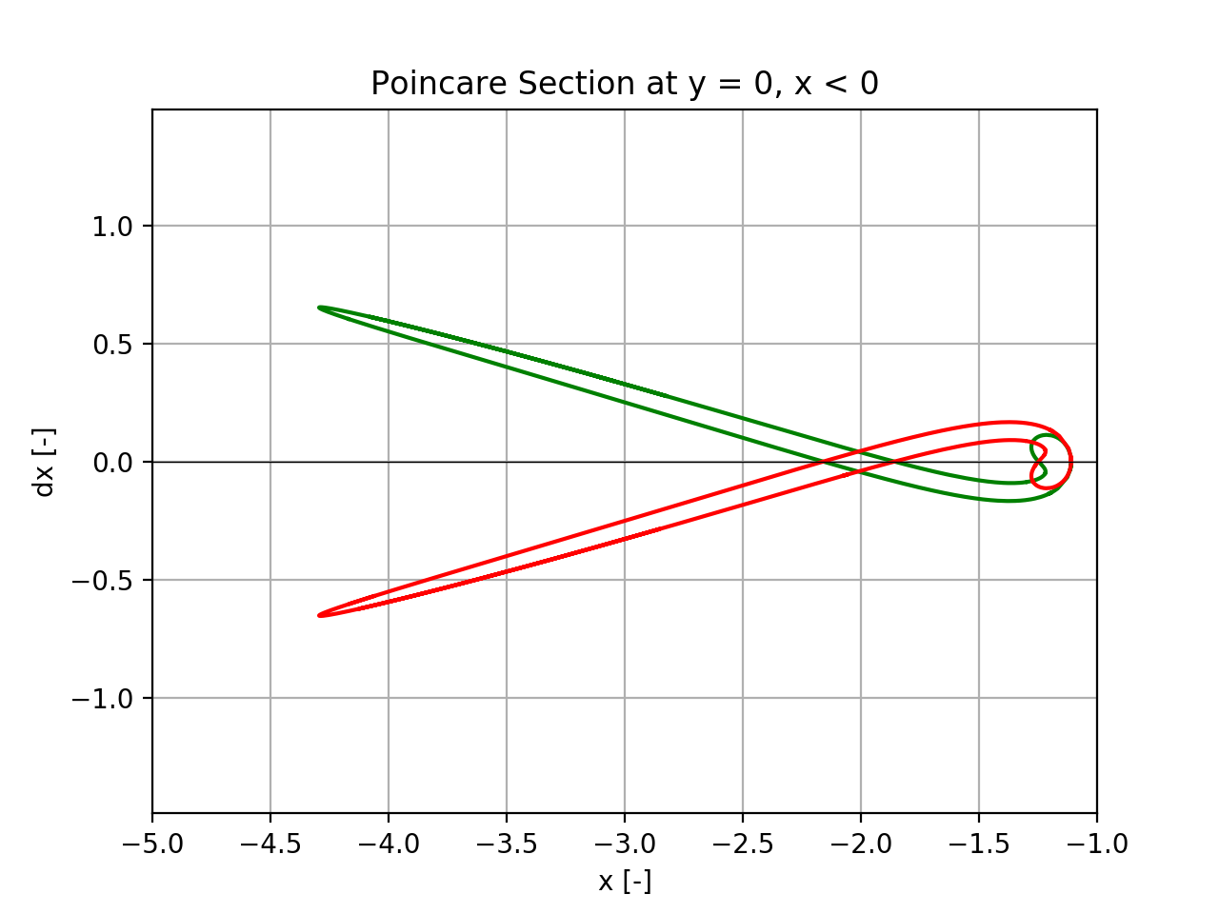
Poincaré Sections & Homoclinic Orbits
A common Poincaré section is y = 0, x < 0 for the exterior L₂ manifolds.

Slide 21
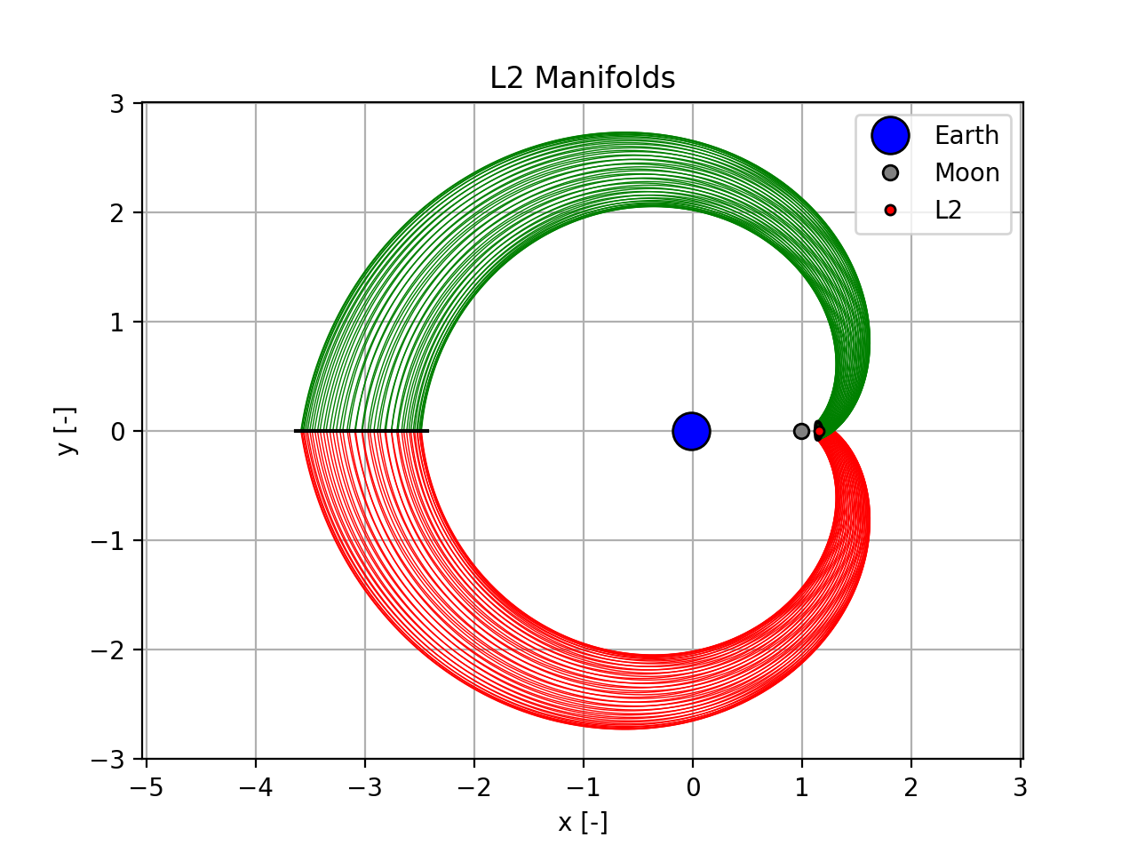
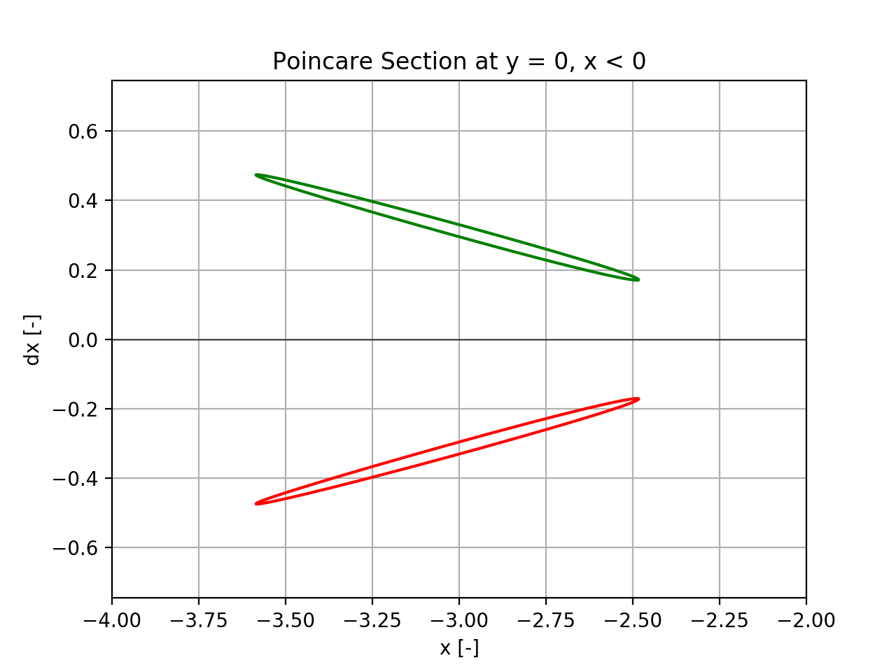
Poincaré Sections & Homoclinic Orbits
Not every periodic orbit has homoclinic orbits!

Slide 22
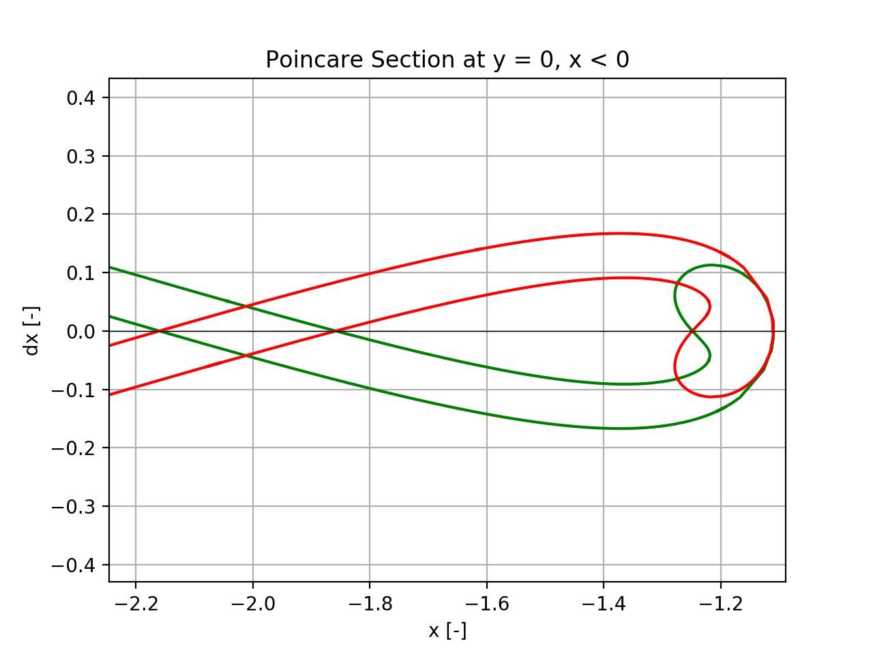
Poincaré Sections & Homoclinic Orbits
Intersection of the stable and unstable manifolds on the Poincaré section correspond to homoclinic orbits.
Notes:
Line dx = 0 are symmetric homoclinic orbits
Other are asymmetric orbits

Slide 23
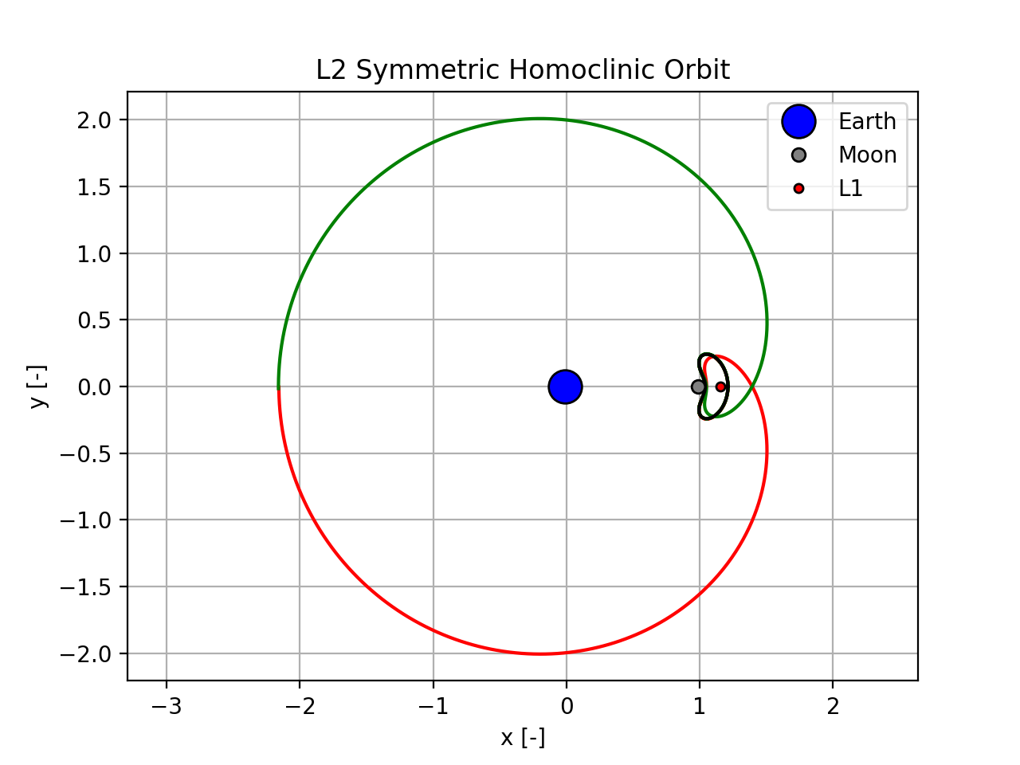
Poincaré Sections & Homoclinic Orbits

Slide 24
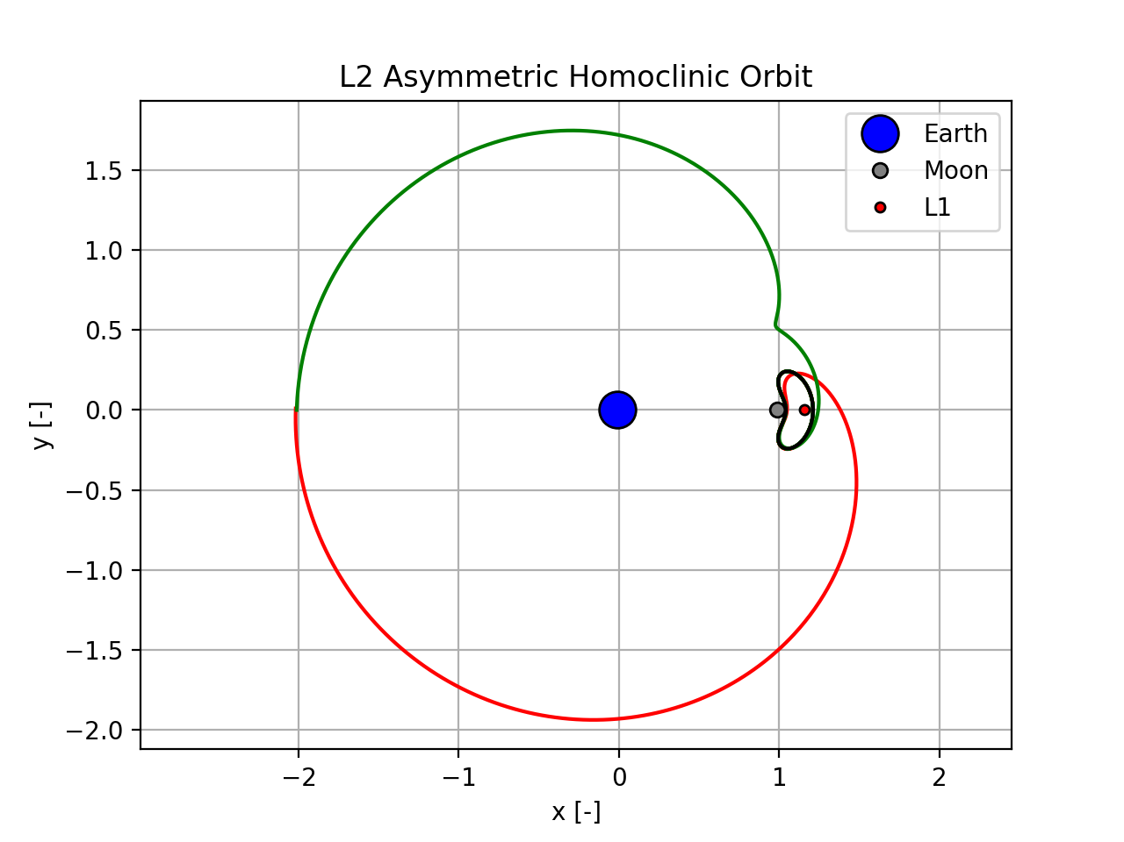
Poincaré Sections & Homoclinic Orbits

Slide 25


Significance and Usefulness of Homoclinic Orbits
Understand the flow of dynamic systems
For mission design, heteroclinic are generally more valuable
Notes:
-Homoclinic orbits can help understand flow of dynamic system, but for mission design, heterclinic orbits are of much greater use (moon transfers, etc)
-Can cite some papers

Slide 26

Questions?

Slide 27

Questions?

Slide 28


Questions

Slide 29
Extra Slides

Slide 30





Starting FFA
Lyapunov Center Theorem
Use eigenvalue and eigenvectors of center manifold of Df*
$$εv_{1}$$
$$v=v_{1}+iv_{2}$$
$$T=\frac{2π}{λ}$$
$$x^{∗}$$
$$εv_{2}$$

Slide 31
References
https://en.wikipedia.org/wiki/Henri_Poincare

